Slide 1

Sundance Bay Case Study
Abinav Yadamani

Slide 2
Agenda
Data Description
Inconsistencies & Assumptions
Loan Performance Insights
Top 10 Investor ROI
Loan To Value Analysis
Recommendations

Slide 3




Data Description
3 datasets – Investors, Loans and Property
Relationship:
Property Types: Commercial, Mixed-Use & Residential
Loan Status Types: Active, Paid Off & Defaulted
Investor
Loan
Property

Slide 4
Inconsistencies & Assumptions
Loan Amount >= Investment Amount.
Unusually high LTV’s.
Same day loan start & end dates.
Unused Investment amount = 0 ROI for investors on that amount.
Defaulted Loan amount = 100% loss of investment amount for investor.
Loan Term >0: Assumed Compound Interest EMI for ROI.
Loan Term =0: Assumed Simple Interest.

Slide 5
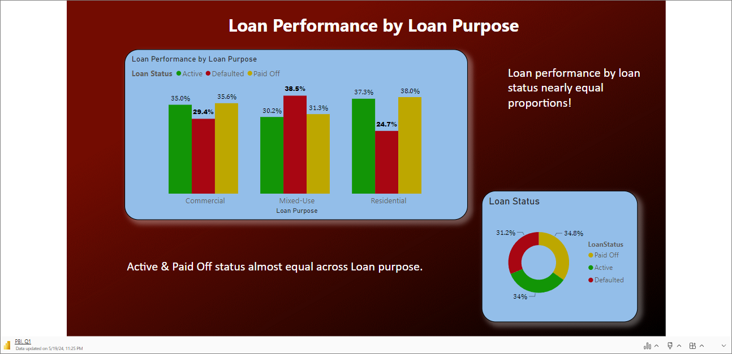
Loan Performance

Slide 6
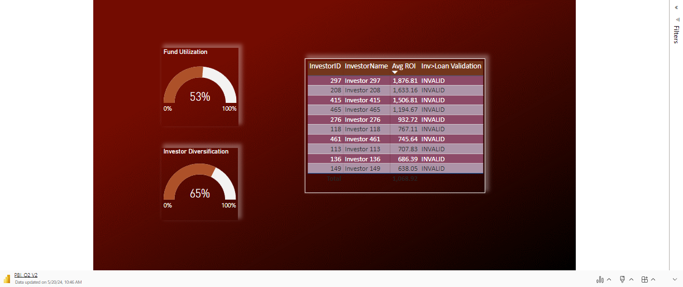
Top 10 Investor Analysis

Slide 7
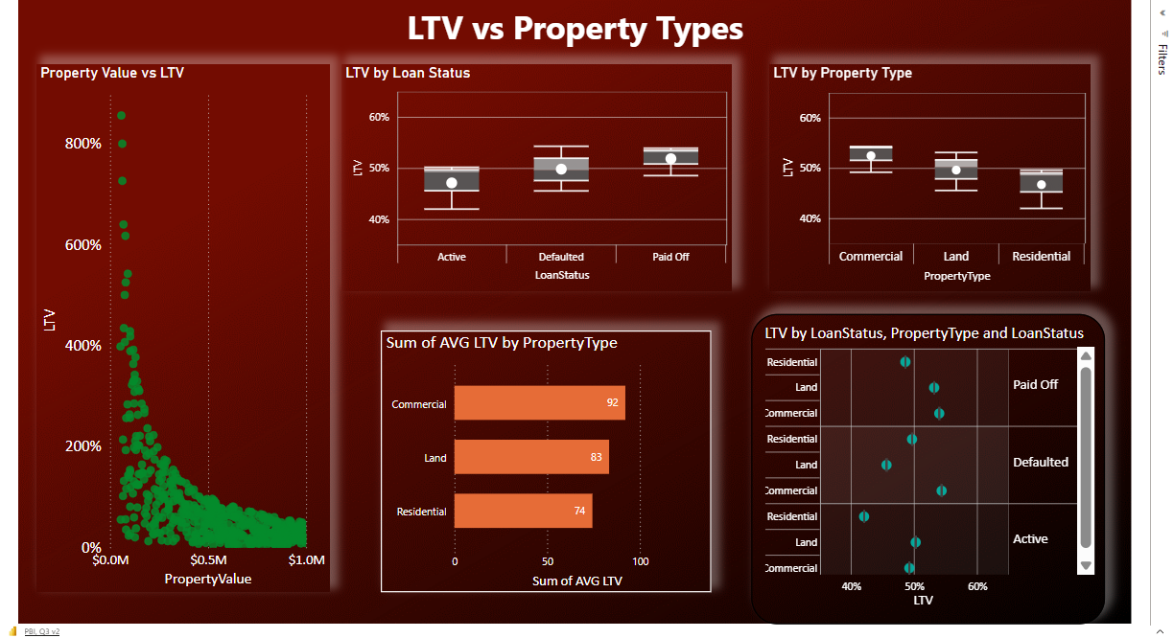

Slide 8
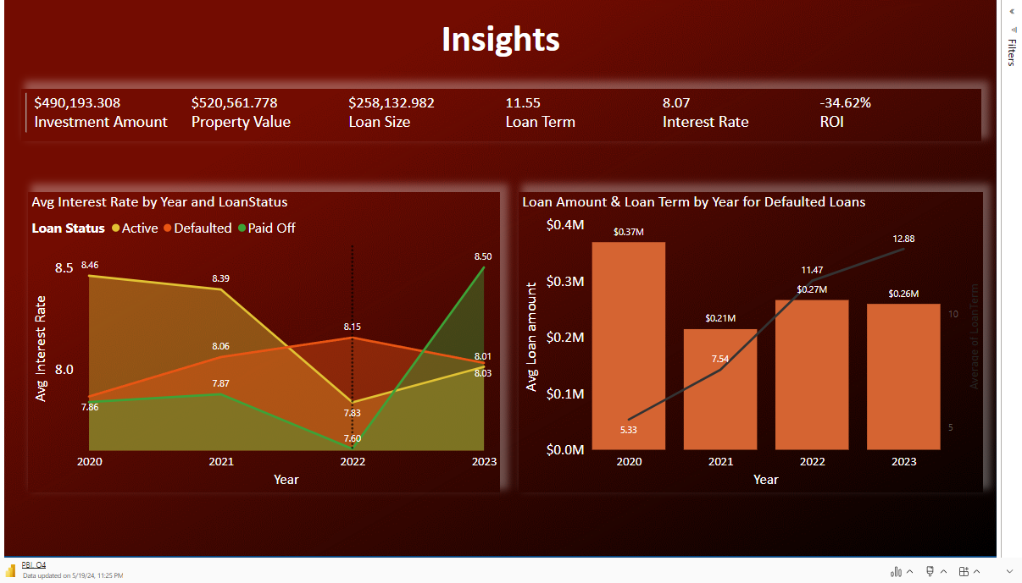

Slide 9
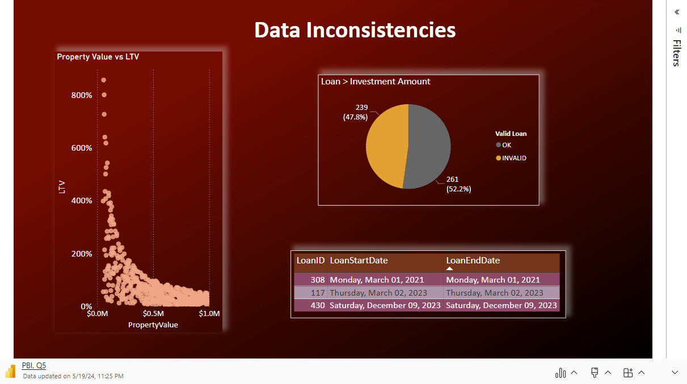

Slide 10
Recommendations
Immediate next step – Credit Risk ML Model Active loans to predict risky loans and take necessary actions to prevent loan defaults.
Improve investment amount fund utilization.
Diversify loan delegation to cover broader investors.
Lower Loan Term/Interest Rates.
Tailored credit limits, interest rates based on risk.

Slide 11

Thank You!!
Questions??

Slide 12
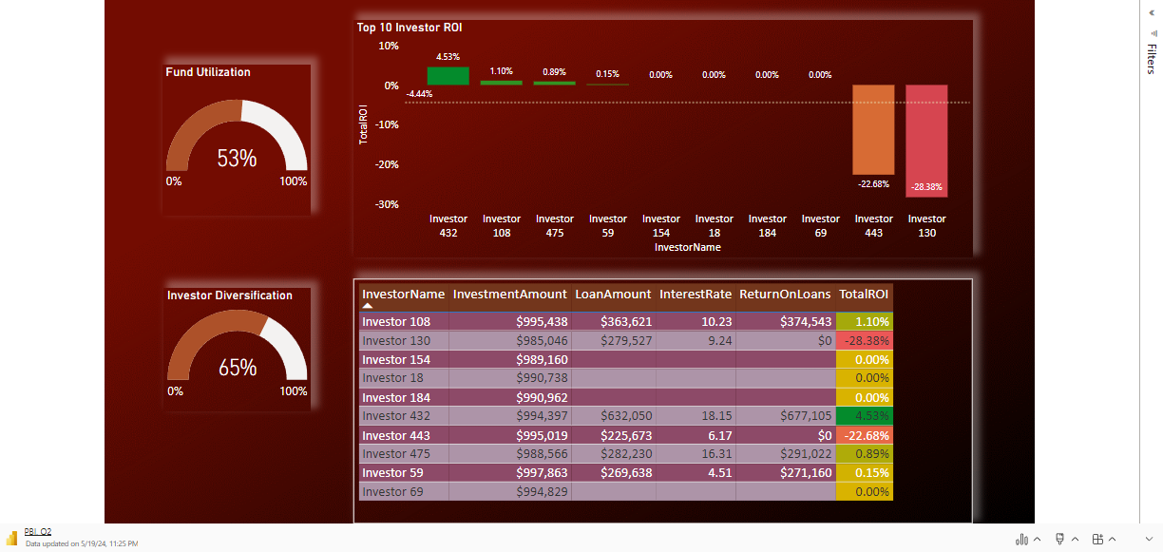
Top 10 Investor Analysis

Slide 13
